Slide 1
Swift Lesson Nr1
Power point is on Canvas, you will need to annotate it as you follow the lesson

Slide 2
Swift Overview
Announced at Apple’s Worldwide Developer’s Conference in June 2014
Brand new, level playing field
Similar to Objective-C, Apps can operate with Objective-C code or Swift code

Slide 3
Swift Overview
Platforms: IOS, Mac OS X
Many free development tools, more coming
Some good documentation

Slide 4
Swift Overview
Plenty of overlap with other high level languages
if…
for..
while…
switch…case…

Slide 5
Swift Overview
Resources: in Canvas folder Swift
Reserved words
Operators
Please download these.
You should not and in some cases cannot use reserved words for variable names

Slide 6
Swift Demo Program
The demo program works, it allows you immediately to start working with Swift code
At the front are some “Exploration” statements

Slide 7
Swift Demo Program
Concepts you will explore, and that will be explained in a few Swift lessons are
Three I/O functions that you may cut and paste into future Console programs
Functions
Variables
A Pythagorean function that doesn’t quite work correctly

Slide 8
Swift Demo Program (cont.)
Concepts
Two types of Swift comments
Two “escape characters”; \n, \t
A Pythagorean function that doesn’t quite work correctly
Too many decimal places, how to format

Slide 9
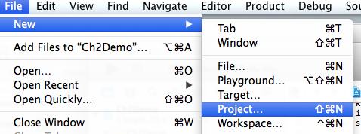
Swift Demo Program
Open XCODE….
Create a new project

Slide 10
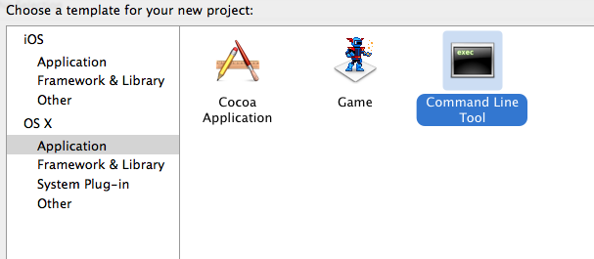
Swift Demo Program
Identify the type of project

Slide 11
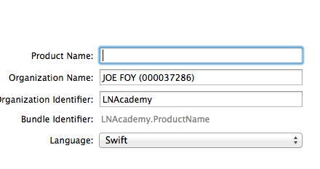
Swift Demo Program
Name the project
Type Ch2Demo

Slide 12
Swift Demo Program
Now, go to the Swift Canvas folder and download file “Ch2Demo.docx” from folder Ch2Demo
Copy and paste the code from downloaded file into your XCODE Editor panel

Slide 13
Explorations
(walk through these)
To run your code, click the green right pointing arrow at the top. You should see the “Build Succeeded hammer Icon”
If you do not, then there is a compile time error that must be fixed

Slide 14
Explorations
As you complete an exploration, add a few comment lines in the appropriate exploration area, that tells what happened.
Good reference for you for quizzes and tests
Please do the explorations…...

Slide 15
Exploration 1
What happened when you changed from // to /* ?

Slide 16
Exploration 3
What does the terminator statement at the end of a print statement do?

Slide 17
Exploration 4
Did you receive the correct average for 90 + 90 + 92?

Slide 18
Exploration 5
Did the comparison print out a correct statement when g1 and g2 were equal?

Slide 19
Exploration 6
What does the \n escape sequence do inside a printed string?

Slide 20
Exploration 7
What do you think would have happened if you just kept reusing the same grade variables, instead of adding new ones?

Slide 21
Exploration 8
When we learn about loops (for…), you will discover a more efficient way to print the same line or lines many times

Slide 22
Exploration 9
\t inside a printed string is another escape character
As was the case with \n, these same escape characters are used in many (most?) programming languages to format output

Slide 23
Exploration 10
You are writing your own code already…

Slide 24
Exploration 11
When using functions provided by Swift or another programmer, it is important to know what we need to provide the function, and what it returns

Slide 25
Exploration 12
Many (all?) programming languages provide ways to format output

Slide 26
Wow
That was a lot of work, but notice what you have done:
Created a console project, copied a file into it
Have a copy of three functions that you will reuse in other programs
Made slight changes to a program, that work
Added lines of code to a program, that work

Slide 27
References
There is a Swift Version 2.2 IBOOK, which describes all of the details in Swift
Another useful reference is an online language guide
I added a link to it from our Canvas page this weekend

Slide 28
References
You might want to open the link, bookmark it
(To keep your bookmark listing from getting too large, consider adding bookmark folders; i.e. APCSP, and putting links in there)

Slide 29
Swift Lesson Nr1
A Swift program consists of
Reserved words
Syntax
Variables and\or constants
Operators
Functions; some that you write, some that come from provided libraries

Slide 30
Reserved words
Canvas Swift folder, file “Swift Reserved words.pdf”
Reserved means that you cannot use these as variable names in your program

Slide 31
Reserved words
About 20 of these are also reserved words in the Java programming language
Reserved words are listed in the Language guide

Slide 32
Syntax Basics
Not as rigid as other programming languages
Notably, do not need to have semicolon at the end of each line of code
Single line comments start with //
Multi line comment start with /*, end with */

Slide 33
Swift and other languages…
Can change length of arrays after they are created
Has an automatic “break” at the end of each case in a switch-case statement; you do not need to include the word “break”
Can use strings in case statements
Can use number ranges in case statements

Slide 34
Swift and other languages…
Can return more than one value from a function
Functions = methods
Curly braces { } are required around every control statement’s body, even if the control statement is only a single line of code
Will learn other details as we go….

Slide 35
Variables and\or Constants
Variables are also known as identifiers in many programming language
These are words you choose to represent values in a program
Represent = abstraction

Slide 36
Variables and\or Constants
Constants are identified by the reserved word let
A constant’s value cannot be changed after it is assigned

Slide 37
Variables and\or Constants
Variables can be identified with the reserved word var
Don’t use reserved words for variable names

Slide 38
Variables and\or Constants
Please go to section “The Basics” of the Swift Language Guide and then to paragraph “Naming Constants and Variables”
Find this and read it, then decide which variable names on the following slide are valid

Slide 39
Variables and\or Constants
X1
Earth©
1x
Miles_per_gallon
Square meter
X+Y

Slide 40
Operators
Many (not all) of the Swift Operators are listed in file “SwiftOperators.pdf”
Arithmetic
Compound
Comparison
Logical
Unique
Bitwise

Slide 41
Arithmetic Operators
(Swift Language guide, “The Basics” section, paragraph “Basic Operators”
Remainder or modulus arithmetic operator
Gives the remainder of a division operation
Works with decimal numbers in Swift
(examples)

Slide 42
Remainder (Modulus) Operator
7 % 4 =
11 % 4 =
9 % 3 =
3.0 % 1.5 =
3.5 % 1.5 =

Slide 43
Arithmetic Operators
Increment and decrement operators
i++ is the same as i = i + 1
i-- is the same as i = i - 1

Slide 44
Logical Operators
Not returns the inverse of a boolean
a | !a
F | T
T | F

Slide 45
Logical Operators
AND: only returns “true” if both operands are “true”. Both must be true for the result to be true
a | b | a && b
F | F | F
F | T | F
T | F | F
T | T | T

Slide 46
Logical Operators
OR: Returns “true” if either of the operands are “true”. One must be true for the result to be true
a | b | a || b
F | F | F
F | T | T
T | F | T
T | T | T

Slide 47
Functions
Functions are modules of code that you write and use
Swift functions can return 0, 1, or more than 1 values
Check function Pythagorean in Ch2Demo file; it returns both the magnitude of a vector and the angle

Slide 48
Reasons You Define a Function
The same lines of code need to be repeated many times; instead use a function and “call” it
To make another set of code easier to understand. For instance a “main” block might have five function calls.

Slide 49
Summary: Know…
The five typical elements of a Swift program are….
Definition of “reserved word”
How the % operator works
How the increment and decrement operators work
How the AND, OR logical operators work, and their symbols

Slide 50
Summary: Know
When you would write and use a function
How to recognize a valid variable name
How to identify a variable, and how to identify a constant in a program, plus what the difference between the two is

Slide 51
Writing Swift from Pseudo Code
Following the example at the beginning of this power point, create a new project titled Lab2
Download .docx file “SecondSwiftProgram” from Canvas
Copy code into “main” for the new project

Slide 52
Writing Swift from Pseudo Code
Notice that function discriminant does not do anything (yet)
Write Swift statements that implement your pseudo code
Inputs and prompts: see other functions in the program
Calculations: remember the arithmetic operators
(continued next slide)

Slide 53
Writing Swift from Pseudo Code
Even though we haven’t explored the ..if.. else.. conditional statement yet, using the one inside the Chapter 2 demo file, please include an … if.. else ... statement in your discriminant code
Depending upon value of discriminant, it should print the number and type of roots

Slide 54

Questions?

